Slide 1
Enterprise Service Bus

Slide 2
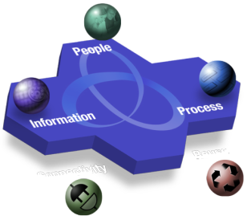

Connectivity – an SOA Entry Point Allowing IT to deliver business agility
Connectivity establishes links between applications and services to:
Deliver a robust and resilient connectivity infrastructure
Provide integration between different Lines of Business without adding complexity
Bring together new and existing IT assets
Notes:
-Define Connectivity: Middleware that…
-Connectivity is a major market opportunity on its own
-ESB & Connectivity
-Messaging
----------------------------------
Main Point: IBM has defined five distinct and inter-related SOA entry points to help our customers succeed with SOA. These entry points are driven by both business and IT needs.
Let's talk a little more about the SOA entry points we mentioned. The focus of the remainder of this discussion is going to be on how IBM is seeing successful companies approach SOA. We'll go through each of these five entry points one by one and talk about how businesses are seeing real value by undertaking projects focused on these areas on their and in combination with other entry points. We'll discuss the business outcomes as well as some of the IT underpinnings of these entry points.

Slide 3
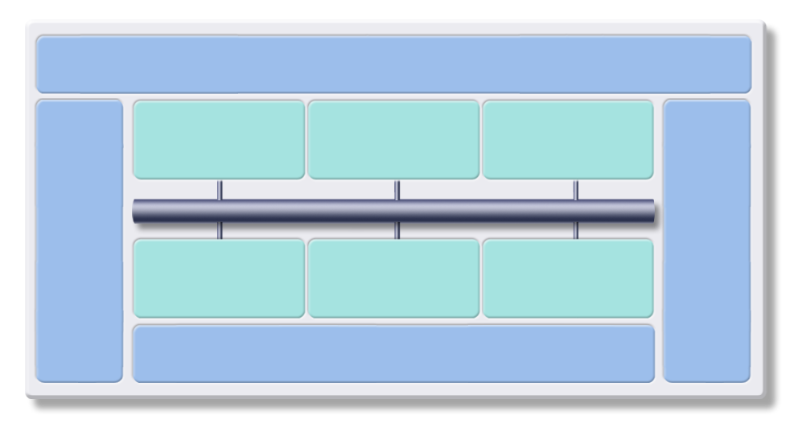
Connectivity and the SOA Reference Architecture
Business Services
Supports enterprise business process and goals through businesses functional service
Interaction Services
Process Services
Information Services
Development Services
Enables collaboration between people, processes & information
Orchestrate and automate business processes
Manages diverse data and content in a unified manner
Management Services
Integrated environment for design and creation of solution assets
Enterprise Service Bus
Manage and secure services, applications & resources
Partner Services
Business App Services
Access Services
Apps &
Info Assets
Connect with trading partners
Build on a robust, scaleable, and secure services environment
Facilitate interactions with existing information and application assets
Infrastructure Services
Optimizes throughput, availability and utilization
Notes:
**Main point: The SOA reference architecture is a vendor-neutral way of looking at and planning the set of services that go into building an SOA. It's a visual tool for laying out projects at a service level.
Let's take a look at how some of these companies are looking at the more technical, architectural ways of laying out their SOA projects. It's called the SOA Reference Architecture
The SOA reference architecture is a way of looking at the set of services that go into building an SOA. This architecture is not unique to IBM; these are things that you need to consider when approaching SOA regardless of what products and services are used. These capabilities can be implemented on a build-as-you-go basis allowing capabilities and project level solutions to be easily added as new requirements are addressed over time. You can see that these services organized along the same lifecycle we’ve discussed. On the left in is Development Services which is model and assemble, in the middle are the elements of the deployment run-time environment you use and on the right is management. The backbone of the reference architecture is the enterprise service bus which facilitates communication between services. The reference architecture is a great tool for laying out roadmaps for pursuing SOA. Regardless of what kind of project you’re undertaking, it makes sense to lay it out on a reference architecture to see how the various services you’re designing are going to interact with each other
Additional detail:
The SOA Reference Architecture outlines the key capabilities that are required for comprehensive, enterprise wide SOA solutions. These capabilities can be implemented on a build-as-you-go basis allowing capabilities and project level solutions to be easily added as new requirements are addressed over time.
Tools are an essential component of any comprehensive integration architecture. The SOA Architecture includes both Development Services which are used to implement custom artifacts that leverage the infrastructure capabilities, and Business Innovation & Optimization Services which are used to monitor and manage the runtime implementations at both the IT and business process levels.
At the core of the SOA Reference Architecture is the Enterprise Service Bus. This delivers all of the inter-connectivity capabilities required to leverage the services implemented across the entire architecture. Transport services, event services, and mediation services are all provided through the ESB.
The SOA Reference Architecture also contains a set of services that are oriented toward the integration of people, processes, and information:
Interaction Services provide the capabilities required to deliver IT functions and data to end users, meeting the end-user's specific usage preferences.
Process Services provide the control services required to manage the flow and interactions of multiple services in ways that implement business processes.
Information Services provide the capabilities required to federate, replicate, and transform data sources that may be implemented in a variety of ways.
Many of the services in an SOA are provided through existing applications; others are provided in newly implemented components; and others are provided through external connections to third party systems.
Existing enterprise applications and enterprise data are accessible from the ESB through a set of Access Services that provide the bridging capabilities between legacy applications, pre-packaged applications, enterprise data stores and the ESB.
The SOA Reference Architecture also contains a set of Partner Services that provide the document, protocol, and partner management capabilities required for business processes that involve inter-actions with outside partners and suppliers.
Business Application Services provide runtime services required for new application components to be included in the integrated system.
Underlying all these capabilities of the SOA Reference Architecture is a set of Infrastructure Services which are used to optimize throughput, availability and performance.
IT Services Management Services include capabilities that relate to scale and performance, for example edge services, clustering services, and virtualization capabilities allow efficient use of computing resources based on load patterns.
The SOA Reference Architecture is a complete and comprehensive architecture that covers all the integration needs of an enterprise. Its services are well integrated and are delivered in a modular way, allowing SOA implementations to start at a small project level. As each additional project is addressed, new functions can be easily added, incrementally enhancing the scope of integration across the enterprise.
Background:
The IBM SOA Foundation delivers the capabilities you need to adopt SOA through a comprehensive architecture. These capabilities can be implemented on a build-as-you-go basis, and yet, because of the architecture and its service orientation, capabilities and project level solutions can be easily added as new requirements are addressed over time.
The SOA Reference Architecture shows the key capabilities that are required for comprehensive, enterprise wide SOA solutions.
Development Services are an essential component of any comprehensive integration architecture. The SOA Architecture includes development tools, used to implement custom artifacts that leverage the infrastructure capabilities, and business performance management tools, used to monitor and manage the runtime implementations at both the IT and business process levels. Development tools allow people to efficiently complete specific tasks and create specific output based on their skills, their expertise, and their role within the enterprise. Business Analysts who analyze business process requirements need modeling tools that allow business processes to be charted and simulated. Software Architects need tool perspectives that allow them to model data, functional flows, system interactions, etc. Integration Specialists require capabilities that allow them to configure specific inter-connections in the integration solution. Programmers need tools that allow them to develop new business logic with little concern for the underlying platform. Yet, while it is important for each person to have a specific set of tool functions based on their role in the enterprise, the tooling environment must provide a framework that promotes joint development, asset management and deep collaboration among all these people. A common repository and functions common across all the developer perspectives (e.g. version control functions, project management functions, etc) are provided in the SOA Reference Architecture through a unified development platform.
The Business Innovation & Optimization Services incorporate monitoring capabilities that aggregate operational and process metrics in order to efficiently manage systems and processes. Managing these systems requires a set of capabilities that span the needs of IT operations professionals and business analysts who manage the business operations of the enterprise. These capabilities are delivered through a set of comprehensive services that collect and present both IT and process-level data, allowing business dashboards, administrative dashboards, and other IT level displays to be used to manage system resources and business processes. Through these displays and services, it is possible for LOB and IT personnel to collaborate to determine, for example, what business process paths may not be performing at maximum efficiency, the impact of system problems on specific processes, or the relationship of system performance to business process performance. This collaboration allows IT personnel and assets to be tied more directly to the business success of the enterprise than they traditionally have been.
One key feature of the SOA Reference Architecture is the linkage between the Development and the Business Innovation & Optimization Services. The ability to deliver runtime data and statistics into the development environment allows analyses to be completed that drive iterative process re-engineering through a continuous business process improvement cycle.
At the core of the SOA Reference Architecture is the Enterprise Service Bus. This architectural construct delivers all the inter-connectivity capabilities required to leverage and use services implemented across the entire architecture. Transport services, event services, and mediation services are all provided through the ESB. Transport services provide the fundamental connection layer; event services allow the system to respond to specific stimuli that are part of a business process; and mediation services allow loose-coupling between interacting services in the system. The ESB is a key factor in enabling the service orientation of the SOA Reference Architecture to be leveraged in implementing service oriented solutions and can be implemented today to meet the quality of service requirements of any integration solution.
The SOA Reference Architecture also contains a set of services that are oriented toward the integration of people, processes, and information. These services control the flow of interactions and data among people and automated application services in ways appropriate to the realization of a business process:
- Interaction Services provide the capabilities required to deliver IT functions and data to end users, meeting the end-user's specific usage preferences.
- Process Services provide the control services required to manage the flow and interactions of multiple services in ways that implement business processes.
- Information Services provide the capabilities required to federate, replicate, and transform data sources that may be implemented in a variety of ways.
Automated application services, implementations of business logic in automated systems, are a critical part of any integration architecture or solution. Many of these services are provided through existing applications; others are provided in newly implemented components; and others are provided through external connections to third party systems. Existing enterprise applications and enterprise data are accessible from the ESB through a set of access services. These Access Services provide the bridging capabilities between legacy applications, pre-packaged applications, enterprise data stores (including relational, hierarchical and nontraditional, unstructured sources such as XML and Text), etc and the ESB. Using a consistent approach, these access services expose the data and functions of the existing enterprise applications, allowing them to be fully re-used and incorporated into functional flows that represent business processes. Existing enterprise applications and data leverage the Business Application and Data Services of their operating environments such as CICS, IMS, DB2, etc. As these applications and data implementations evolve to become more flexible participants in business processes, enhanced capabilities of their underlying operating environments, for example support of emerging standards, can be fully utilized.
The SOA Reference Architecture also contains a set of Business Application Services that provide runtime services required for new application components to be included in the integrated system. These application components provide new business logic required to adapt existing business processes to meet changing competitive and customer demands of the enterprise. Design and implementation of new business logic components for integration enables them to be fully re-useable, allowing them to participate in new and updated business processes over time. The Business Application Services include functions important to the traditional programmer for building maintainable, flexible, and re-useable business logic components.
In many enterprise scenarios, business processes involve inter-actions with outside partners and suppliers. Integrating the systems of the partners and suppliers with those of the enterprise improves efficiency of the overall value chain. Partner Services provide the document, protocol, and partner management services required for efficient implementation of business-to-business processes and inter-actions.
Underlying all these capabilities of the SOA Reference Architecture is a set of Infrastructure Services which provide security, directory, IT system management, and virtualization functions. The security and directory services include functions involving authentication and authorizations required for implementing, for example, single sign-on capabilities across a distributed and heterogeneous system.
IT Services Management Services include functions that relate to scale and performance, for example edge services and clustering services, and the virtualization capabilities allow efficient use of computing resources based on load patterns, etc. The ability to leverage grids and grid computing are also included in infrastructural services.
While many of the Infrastructure and IT Service Management services perform functions tied directly to hardware or system implementations, others provide functions that interact directly with integration services provided in other elements of the architecture through the ESB. These interactions typically involve services related to security, directory, and I/T operational systems management.
The SOA Reference Architecture is a complete and comprehensive architecture that covers all the integration needs of an enterprise. Its services are well integrated and are delivered in a modular way, allowing SOA implementations to start at a small project level. As each additional project is addressed, new functions can be easily added, incrementally enhancing the scope of integration across the enterprise. In addition to supporting SOA strategies and solutions, the architecture itself is designed using principles of service orientation and function isolation.

Slide 4
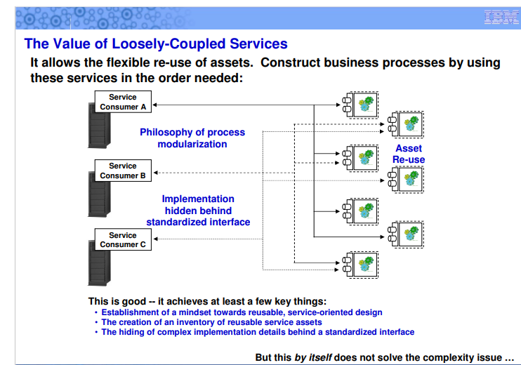

Slide 5
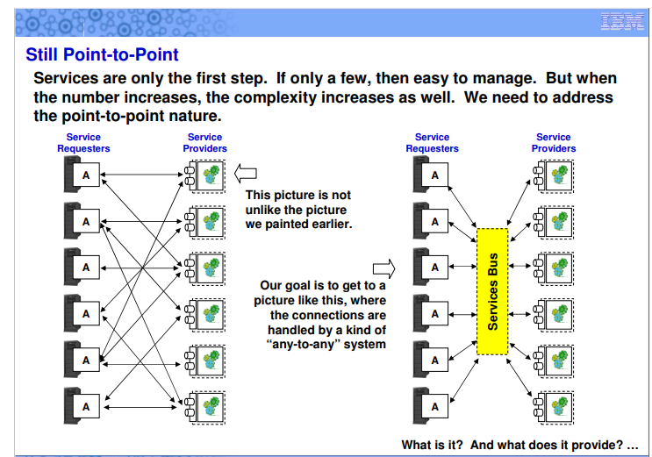

Slide 6
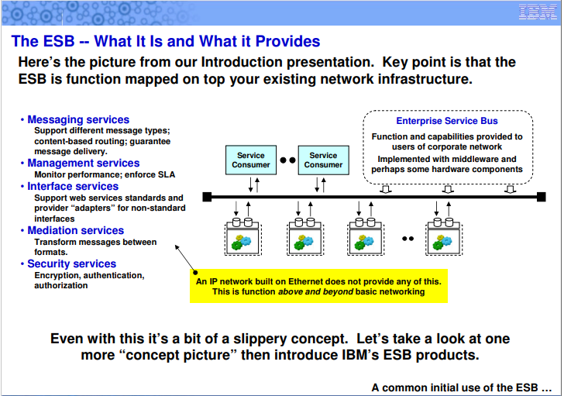

Slide 7
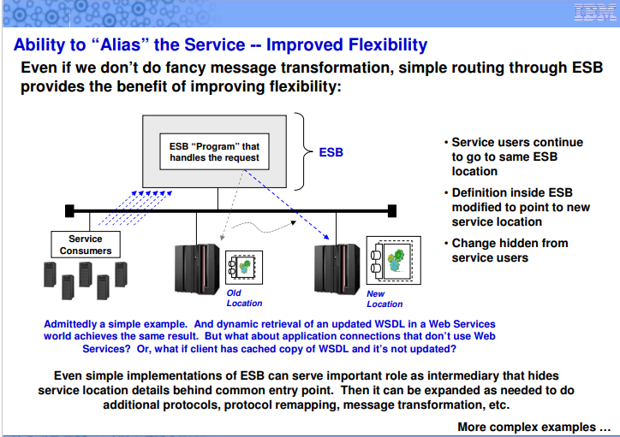

Slide 8
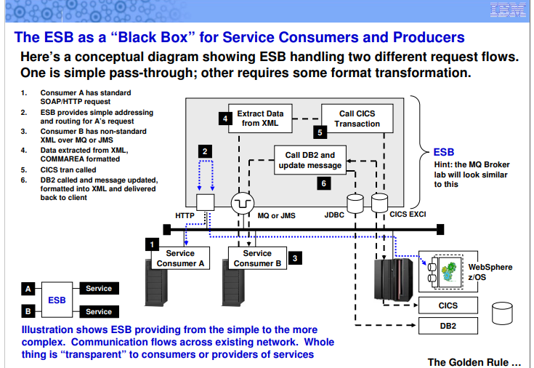

Slide 9
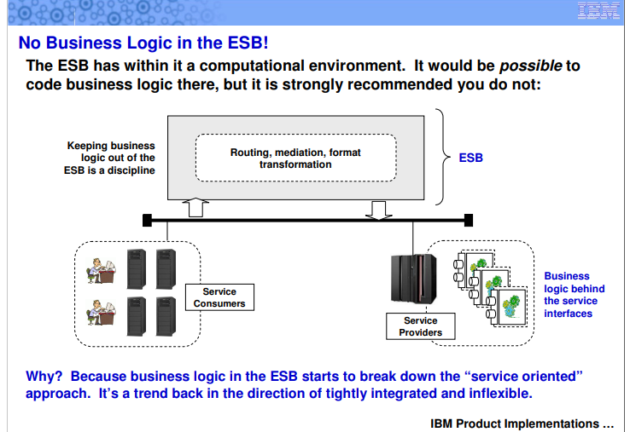

Slide 10


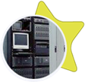
















Service Enrichment should… Be Delivered Through an ESB
An Enterprise Service Bus (ESB) is a flexible connectivity infrastructure for integrating applications and services.
An ESB performs the following between requestor and service
MATCHES & ROUTES communications between services
ESB
CONVERTS between different transport protocols
TRANSFORMS between different data formats
IDENTIFIES & DISTRIBUTES business events
Shape = Transport protocol
Color = Data format
Notes:
The Enterprise Service Bus (ESB) can help you achieve the goal of SOA – in fact the ESB widely accepted as key element at the heart of every successful SOA.
38% of firms have deployed an ESB, and 27% are currently evaluating, Source: WebSphere ACPP Brand Study, 2007
The ESB is a flexible connectivity infrastructure for integrating applications and services. While there is no broad agreement on all of the capabilities which can comprise an ESB, this basic definition is generally accepted by leading analysts and vendors. For example, Roy Shulte of Gartner Group describes an ESB as “A lightweight connectivity infrastructure built using JMS, XML, and Web Services standards.”
The ESB does four basic things:
It MATCHES & ROUTES communications between services
It CONVERTS between different transport protocols
It TRANSFORMS between different data formats
It IDENTIFIES & DISTRIBUTES business events
The flexibility and “service virtualization” provided by the ESB is achieved through what architects call “separation of concerns” – the clear separation between the applications which run the business (including business services and business processes) and the ESB (the infrastructure for connecting applications and services together). This flexibility enables IT change with very limited impact – such as the update or replacement of a given business service, or the development of a new composite solution which leverages existing services. That is the power of the ESB – enabling you to realize the full value of SOA.

Slide 11
Provide Service Enrichment Why ESB mediation?
Reduce the number, size, and complexity of interfaces
Reduces cost / risk involved as business changes / new opportunities arise
Promotes reuse
Dynamic real-time, event-driven SOA
Publishing:
Implementing an ESB based on WebSphere Message Broker a leading digital publishing house in Europe is able to integrate new applications quickly and easily without any need to build and maintain point-to-point connections and provides dynamic information capabilities to its customers
Notes:
-Simplify interfaces
-Reduces cost/risk to change
-Increases agility to respond to opportunities / threats that arise
-Promotes reuse
-Enables real-time, integrated solutions
------------------------------------------------------
Main Point: Decoupling connectivity for SOA requires a comprehensive middleware connectivity layer, capable of handling all connectivity requirements for end to end SOA deployment – known as an ESB – sitting at the heart of the architecture for SOA
So we know we need to address the problems of SOA connectivity, and these days anywhere you go, you will hear that the answer to these problems is an ESB – an Enterprise Service Bus. So why do you need one, and what will it do for you?
Well as we have already seen, today’s connectivity environments can be tremendously complex. And trying to ignore the problem won’t help you to address it – in fact it will only get worse. So if businesses today address that problem using an ESB what will that do to help?
An ESB does a number of tasks to meet connectivity needs. It Matches & Routes messages between services. It Converts transport protocols between requestors and service providers. It Transforms message formats between requestors and service providers, and it Distributes business events to and from disparate sources.
This decoupling of connectivity ensures that interfaces within applications become far less complex, which in turn reduces the costs and risks of changing those applications, and making new uses of them, particularly enabling more applications and functions to be accessed and reused as services. This progress towards a Service Oriented Architecture will allow your business to become more flexible and responsive than ever before.
++++++++++++++++++Not in script
Reduce the number, size, and complexity of interfaces
Move the connectivity and integration logic into an ESB, away from the business logic
Faster and easier to change the way data moves around an SOA
Simplified applications connected through an ESB – easier to service enable
Gets business silos talking - providing a unified view of disparate data from different departments
Service enabled applications easier to reuse across an ESB
Reduce the cost and risk involved in changing your IT systems while keeping them still connected
Reusable services accessed through an ESB are easier and faster to modify and replace
Transform unresponsive, batch-updating IT systems into a dynamic real-time, event-driven SOA
Flexible SOA, with reusable decoupled applications and services, all connected through an ESB
Reliable and secure data movement – anywhere in the enterprise
Application Developers focused on business logic – simplified programming tasks
Dedicated environment – Common tooling, management and operational support

Slide 12

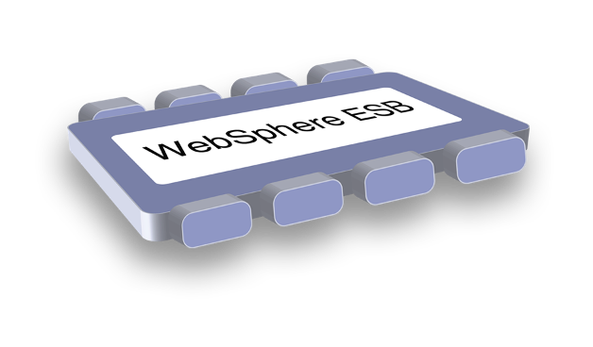
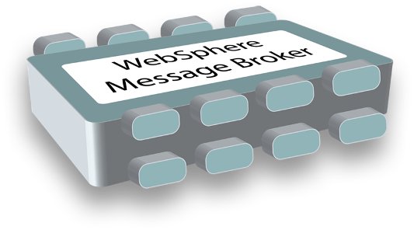

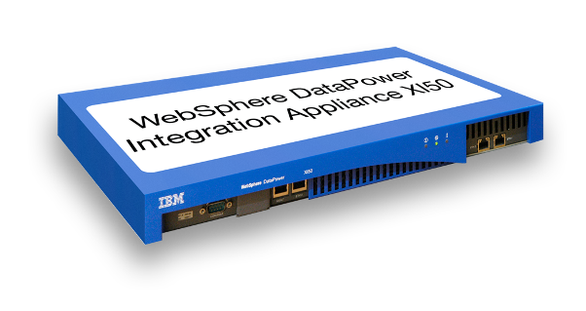
Leading ESB Offerings from IBM Only WebSphere delivers the most complete ESB solution
WebSphere ESB Built on WebSphere Application Server for an integrated SOA platform
WebSphere Message Broker
Built for universal connectivity and transformation in heterogeneous IT environments
WebSphere DataPower Integration Appliance
Purpose-built hardware ESB for simplified deployment and hardened security
Notes:
ESB product family -
WESB - Leading standards platform and alignment w/BPM
WMB - Unparalled depth of integration, track record, and alignment w/WMQ
WDP – Redefines the boundaries of middleware
-There is no wrong choice for customers – continued strategic investment across the portfolio
-Each product delivers complete ESB capability
-Don’t sell a portfolio of products, instead sell the capability and use the portfolio to find the solution that best matches the customer’s needs
----------------------------------
IBM recognizes the needs on meeting different requirements with different ESB implementations. There are three ESB offerings from IBM WebSphere:
WebSphere ESB is ideal for customers who have other solutions on WebSphere Application Server, Portal, or BPM platform. Customers may achieve efficiencies in skills, cost, and time-to-value across middleware products if adding WebSphere ESB to their standards-based IT environment.
On the other hand, for customers whose primary challenge is integrating a wide range of non-standard applications into the standards world, as well as those who make heavy use of WebSphere MQ will value the flexibility and depth of capability provided by WebSphere Message Broker.
And for those who value the simple experience of drop-in installation and admin-based configuration, and require security at the message level, network level, and device level, DataPower Integration Appliance brings that in an integrated solution.

